Slide 1
Lecture 1
Intelligent Systems

Slide 2
Part I: What is AI?

Slide 3
Artificial intelligence (AI) is everywhere!
But what is AI?
Is AI = Machine Learning?
Is AI = Deep Learning?
Is Machine Learning = Deep Learning?
Are we getting close to having “real” AI?

Slide 4
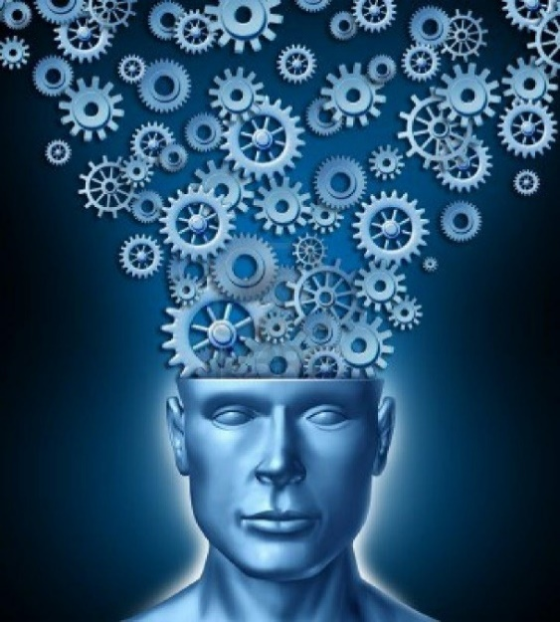
What is the Mind?
The Mind-Body Problem
Dualism: Mind and body are different substances.
Science: Mind is a property of the physical body.
AI is based fundamentally on the scientific view of the mind.
http://frithmind.org/socialminds/wp-content/uploads/sites/4/2014/05/Fig-1.jpg

Slide 5
Two Fundamental Questions
What kind of thing is intelligence?
How can artificial intelligence be built?

Slide 6
The Original Vision
An attempt to build an artificial system that can do the things we consider “intelligent”
“Artificial Intelligence” was coined by John McCarthy of Stanford at the Dartmouth Summer Research Project on Artificial Intelligence in 1956. They stated:
“This study is to proceed on the basis of the conjecture that every aspect of learning or any other feature of intelligence can in principle be so precisely described that a machine can be made to simulate it. An attempt will be made to find how to make machines use language, form abstractions and concepts, solve kinds of problems now reserved for humans, and improve themselves.”

Slide 7
The Original Vision
An attempt to build an artificial system that can do the things we consider “intelligent”
“Artificial Intelligence” was coined by John McCarthy of Stanford at the Dartmouth Summer Research Project on Artificial Intelligence in 1956. They stated:
“This study is to proceed on the basis of the conjecture that every aspect of learning or any other feature of intelligence can in principle be so precisely described that a machine can be made to simulate it. An attempt will be made to find how to make machines use language, form abstractions and concepts, solve kinds of problems now reserved for humans, and improve themselves.”
Learning is important
AI will be a simulation
All functions of intelligence can be described precisely

Slide 8
The Original Vision
An attempt to build an artificial system that can do the things we consider “intelligent”
“Artificial Intelligence” was coined by John McCarthy of Stanford at the Dartmouth Summer Research Project on Artificial Intelligence in 1956. They stated:
“This study is to proceed on the basis of the conjecture that every aspect of learning or any other feature of intelligence can in principle be so precisely described that a machine can be made to simulate it. An attempt will be made to find how to make machines use language, form abstractions and concepts, solve kinds of problems now reserved for humans, and improve themselves.”
Grounded in a reductionistic view of intelligence as a combination of discrete functions, each of which could be accomplished algoritmically using logic as the basis.
Sixty-five years later, we know that things are much more complicated, but the overall approach is still grounded in reductionism, though we have moved past the focus on algorithms.

Slide 9
Intelligence as Computation
Basic Elements:
Everything can be represented in terms of codes → Symbols.
All thought and behavior is manipulation of symbols → Programs.
An intelligent system:
Represents its sensory input in terms of symbols = Perception.
Manipulates these symbols using algorithms = Cognition.
Uses the outputs to trigger response programs = Action.
Responses = choices, decisions, predictions, behaviors, etc.
Learning = Constructing a richer symbol and program repertoire.
Increased intelligence = more complex perception, cognition, action.
Classical AI was based on this symbol manipulation framework
GOFAI

Slide 10
Intelligence as Pattern Recognition
Basic Elements:
The world has a lot of spatiotemporal structure → Patterns.
Every situation requires specific responses → Programs.
An intelligent system:
Recognizes these patterns in its sensory input = Perception.
Maps them into more complex internal representations = Cognition.
Uses these maps to trigger response programs = Action.
Responses = choices, decisions, predictions, behaviors, etc.
Learning = improving pattern recognition and program generation.
Increased intelligence = more complex perception, cognition, action.
Most AI today is based on this pattern recognition framework

Slide 11
Intelligence as Emergent Dynamics
Basic Elements:
The world is a complex multiscale dynamical system → Environment.
The organism is a complex multiscale dynamical system → Body.
The body is embedded in the environment and interacts with it.
Matter and information cycle continually through this coupled system.
The body uses this dynamics to maintain its organizational integrity.
Perception, cognition, behavior, emotion, etc., emerge from this dynamics.
Learning = adapting the organism’s dynamics to improve function.
Increased intelligence = More efficient adaptation to the environment.
This is called the embodied Intelligence framework.
It sees intelligence as just another physical biological process, but one that is accessible to consciousness.

Slide 12
Building Intelligence
Intelligence by Design
Build computer programs that can do smart things.
Put them on a computer with sensory input and verbal or mechanical output.
Fine tune the programs manually or automatically.
Do this separately for all functions of intelligence, and combine.
Intelligence by Learning
Build a (brain-like) system that can learn from data and produce output.
Give the system a lot of data and let it learn.
Test the learning with new data and new situations.
Do this separately for all functions of intelligence, and combine.
Intelligence by Emergence
Build a physical system with sensory input, verbal and mechanical output, simple interacting behaviors, and learning.
Let it learn by experience in the real-world.
Let the functions of intelligence emerge from the experience and learning.

Slide 13
Building Intelligence
Intelligence by Design
Build computer programs that can do smart things.
Put them on a computer with sensory input and verbal or mechanical output.
Fine tune the programs manually or automatically.
Do this separately for all functions of intelligence, and combine.
Intelligence by Learning
Build a (brain-like) system that can learn from data and produce output.
Give the system a lot of data and let it learn.
Test the learning with new data and new situations.
Do this separately for all functions of intelligence, and combine.
Intelligence by Emergence
Build a physical system with sensory input, verbal and mechanical output, simple interacting behaviors, and learning.
Let it learn by experience in the real-world.
Let the functions of intelligence emerge from the experience and learning.
Do these have to be mutually exclusive?

Slide 14



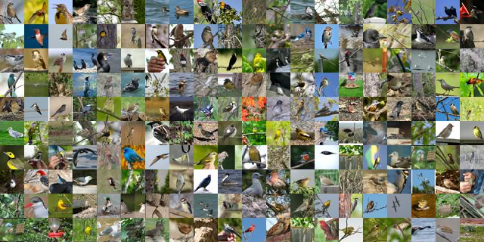
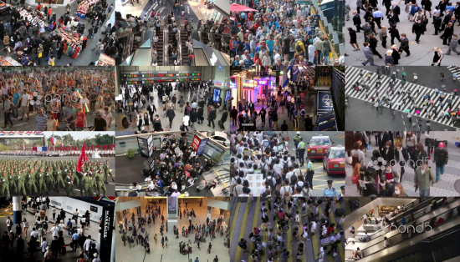
So is this AI?
Memories
Labels
Translations
Decisions
Advice
Explanations

Slide 15
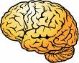


The Classical “Symbolic” View of Intelligence
The mind is abstract computation
The Sense-Think-Act Cycle:
Key Assumption:
Intelligence can be produced by
implementing the abstract processes
of the mind as algorithms
Approach:
Implement algorithms for all the abstract processes.
Design the control mechanisms to make sure that the right ones are used.
This is a fundamentally reductionistic approach.

Slide 16
Is the brain really a computer?

Slide 17
Is the brain really a computer?
The brain is like a computer:
Perception = Input.
Cognition = Processing.
Action = Output.
The Computer Metaphor:
Information processing = computation

Slide 18
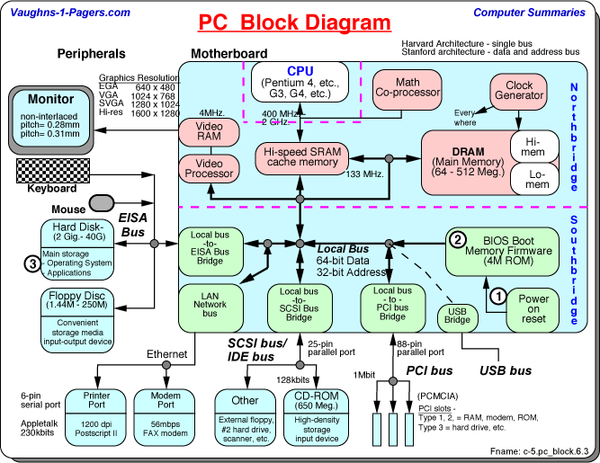
Is the brain really a computer?
The brain is like a computer:
Perception = Input.
Cognition = Processing.
Action = Output.
The Computer Metaphor:
Information processing = computation
But is it this kind of computer?
http://www.vaughns-1-pagers.com/computer/pc-block-diagram.htm

Slide 19
Both brains and digital computers:
Are physical systems.
Use electrical signaling.
Acquire, process, and output information.
Store and recall information.
Are versatile, general-purpose information processors.

Slide 20
Both brains and digital computers:
Are physical systems.
Use electrical signaling.
Acquire, process, and output information.
Store and recall information.
Are versatile, general-purpose information processors.
But only the brain:
Is a self-organizing, adaptive, analog dynamical system.
Uses “slow” chemical components to achieve “fast” functionality.
Processes information in distributed networks.
Stores information extensively rather than locally.
Accesses memory by association, not address.
Embodies its “programs” in its physics.

Slide 21
Both brains and digital computers:
Are physical systems.
Use electrical signaling.
Acquire, process, and output information.
Can store and recall information.
Are versatile, general-purpose problem solvers.
But only the brain:
Is a self-organizing, adaptive, analog dynamical system.
Uses “slow” chemical components to achieve “fast” functionality.
Processes information in adaptive networks.
Stores information extensively rather than locally.
Accesses memory by association, not address.
Embodies its “programs” in its physics.
Brains are special – not like ordinary computers…

Slide 22
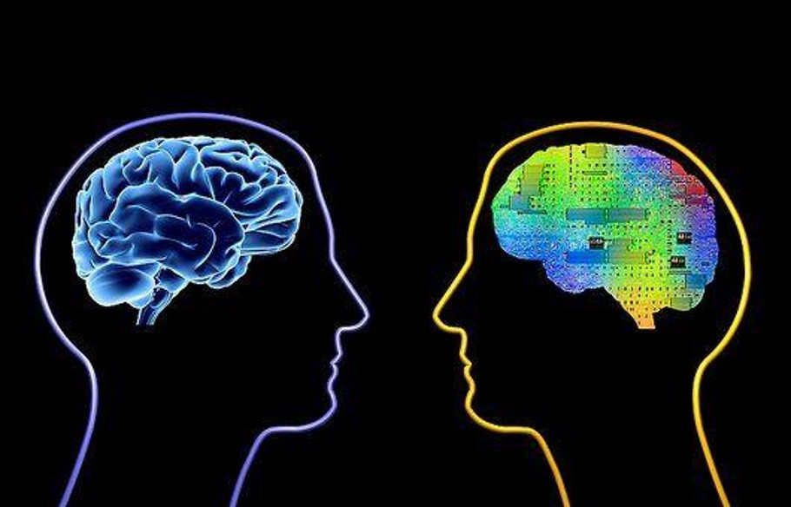
AI Today
network of
biological neurons
network of
artificial neurons
Image from KDNuggets
Most AI today uses neural networks – inspired by the brain – as the basis of machine learning.

Slide 23
The Brain-Based View of Intelligence
The mind emerges from the brain
Neural Networks:
Key Assumption:
Intelligence arises from the interaction
of many neural networks operating in
parallel.
Approach:
Build the neural networks
Design their interaction network.
The system’s behavior is modified by changing connections
Learning

Slide 24
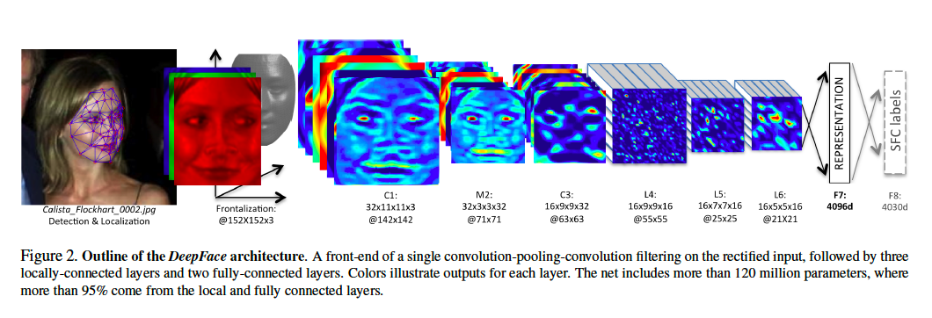

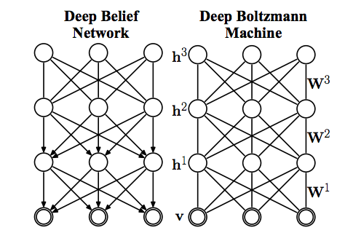
Deep Learning
Deep learning systems are neural networks with many layers of neurons.
Different layers may performs distinct functions.
https://gigaom.com/2015/03/06/how-paypal-uses-deep-learning-and-detective-work-to-fight-fraud/
https://www.quora.com/What-is-the-difference-between-a-deep-Boltzmann-machine-and-a-deep-belief-net
http://neuralnetworksanddeeplearning.com/chap6.html

Slide 25
So is this AI?
Memories
Labels
Translations
Decisions
Advice
Explanations

Slide 26
Part II: AI Today

Slide 27
The New AI

Slide 28
The New AI
Machine Learning
+
Big Data
+
Extremely Fast Computing
+
Frameworks & Libraries

Slide 29
The New AI
Neural networks / deep learning
Statistical / Bayesian models
Graphical models
Generative models
Machine Learning
+
Big Data
+
Extremely Fast Computing
+
Frameworks & Libraries

Slide 30
The New AI
Machine Learning
+
Big Data
+
Extremely Fast Computing
+
Frameworks & Libraries
On-line / streaming data.
Distributed databases.
Analytics.
Visualization.

Slide 31
The New AI
Machine Learning
+
Big Data
+
Extremely Fast Computing
+
Frameworks & Libraries
Multithreading.
Cluster computing.
GPU systems.
Neuromorphic chips.

Slide 32
The New AI
Machine Learning
+
Big Data
+
Extremely Fast Computing
+
Frameworks & Libraries
Hadoop / MapReduce
scikit
Watson
Tensorflow

Slide 33
What does the New AI do?
Discover patterns in complex data.
Discover latent features for embedding data.
Classify data based on features.
Make predictions based on data.
Recognize objects, faces, etc., in images and video streams.
Analyze, generate and translate text.
Learn to make near-optimal choices in complex situations (e.g. games).
Build bots and agents for specific applications.
Enable intelligent autonomous behavior in robots, vehicles, etc.
……… and much more ….
“AI is the new electricity” Andrew Ng (Stanford University)

Slide 34
What does the New AI do?
Discover patterns in complex data.
Discover latent features for embedding data.
Classify data based on features.
Make predictions based on data.
Recognize objects, faces, etc., in images and video streams.
Analyze, generate and translate text.
Learn to make near-optimal choices in complex situations (e.g. games).
Build bots and agents for specific applications.
Enable intelligent autonomous behavior in robots, vehicles, etc.
……… and much more ….
All based on pattern recognition
“AI is the new electricity” Andrew Ng (Stanford University)

Slide 35
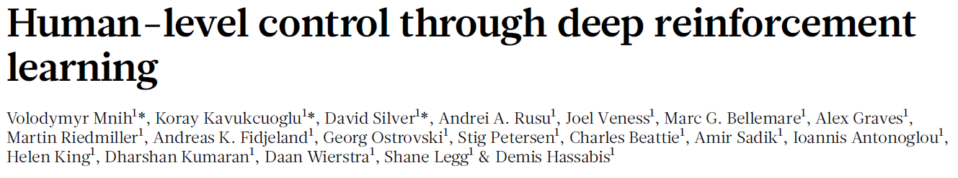
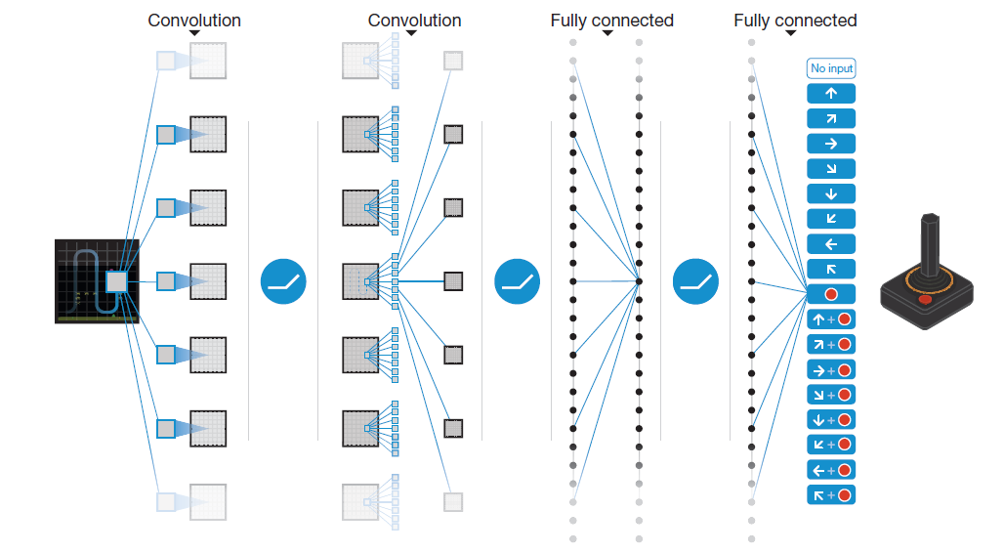
The New AI and Its Successes
Deep learning and related methods have achieved spectacular successes!

Slide 36
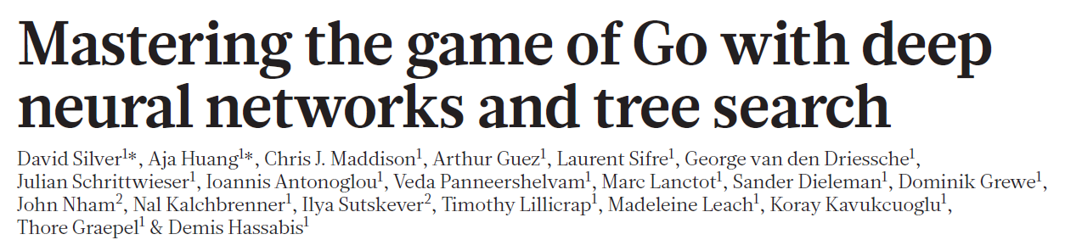
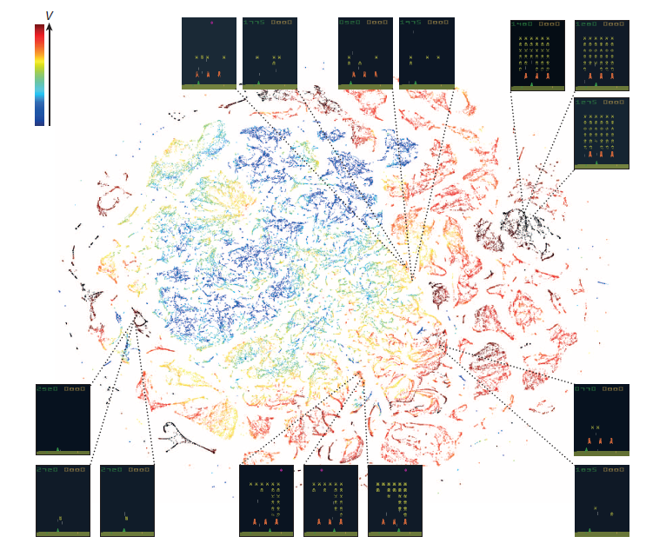
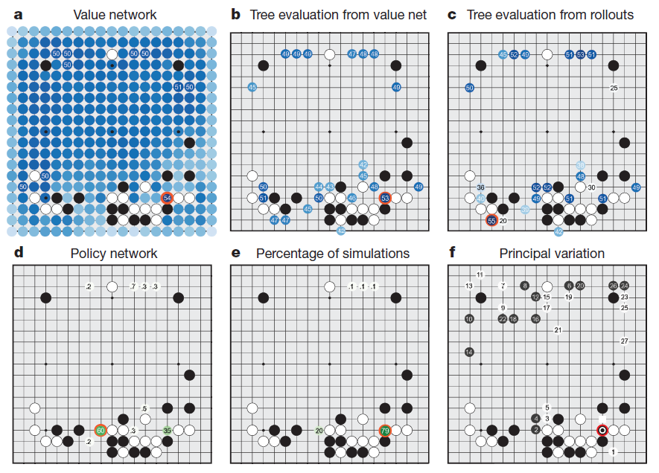
Silver et al. (2016) Nature 529: 484 - 491
Mnih et al. (2015) Nature 518: 529 - 533

Slide 38
GPT2
https://openai.com/blog/better-language-models/
In a shocking finding, scientist discovered a herd of unicorns living in a remote, previously unexplored valley, in the Andes Mountains. Even more surprising to the researchers was the fact that the unicorns spoke perfect English.
The scientist named the population, after their distinctive horn, Ovid’s Unicorn. These four-horned, silver-white unicorns were previously unknown to science.
Now, after almost two centuries, the mystery of what sparked this odd phenomenon is finally solved.
Dr. Jorge Pérez, an evolutionary biologist from the University of La Paz, and several companions, were exploring the Andes Mountains when they found a small valley, with no other animals or humans. Pérez noticed that the valley had what appeared to be a natural fountain, surrounded by two peaks of rock and silver snow.
Pérez and the others then ventured further into the valley. “By the time we reached the top of one peak, the water looked blue, with some crystals on top,” said Pérez.
Pérez and his friends were astonished to see the unicorn herd. These creatures could be seen from the air without having to move too much to see them – they were so close they could touch their horns.
While examining these bizarre creatures the scientists discovered that the creatures also spoke some fairly regular English. Pérez stated, “We can see, for example, that they have a common ‘language,’ something like a dialect or dialectic.”
Dr. Pérez believes that the unicorns may have originated in Argentina, where the animals were believed to be descendants of a lost race of people who lived there before the arrival of humans in those parts of South America.
While their origins are still unclear, some believe that perhaps the creatures were created when a human and a unicorn met each other in a time before human civilization. According to Pérez, “In South America, such incidents seem to be quite common.”
However, Pérez also pointed out that it is likely that the only way of knowing for sure if unicorns are indeed the descendants of a lost alien race is through DNA. “But they seem to be able to communicate in English quite well, which I believe is a sign of evolution, or at least a change in social organization,” said the scientist.

Slide 39
Part III: AI vs. Natural Intelligence

Slide 40
So have we achieved “real” AI already?

Slide 41
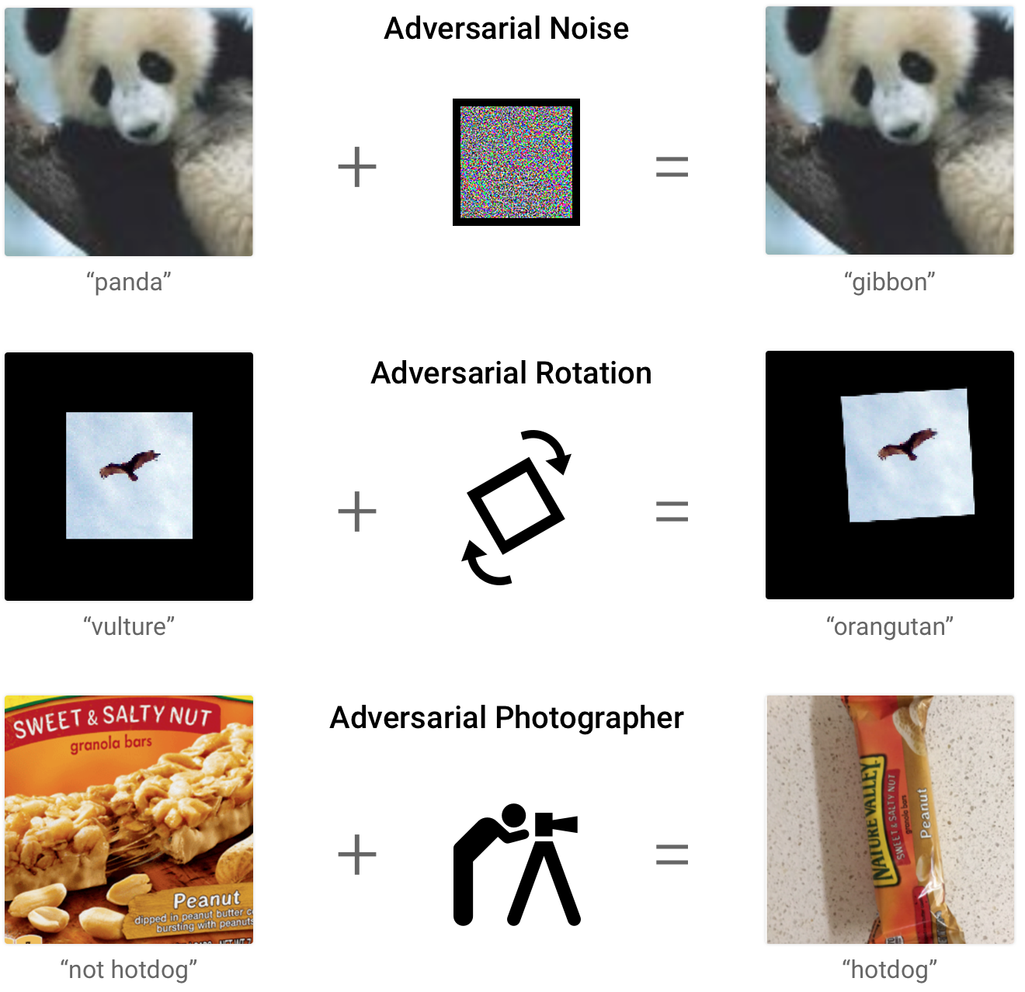
So have we achieved “real” AI already?
Apparently not!
Even sophisticated AI programs are fooled easily by things that would not fool any intelligent animal.
But are we at least headed in the right direction?
https://ai.googleblog.com/2018/09/introducing-unrestricted-adversarial.html
We have taken important steps, but what we have achieved so far is really:
Augmented Intelligence: Using machine learning to amplify human intelligence
Intelligent Analytics: Using machine learning to find patterns in big data.
Intelligent Automation: Systems capable of making intelligent decisions.

Slide 42
Writing with the Transformer… (Hugging Face)
Let there be light! Let there be dark! Let there be light! Let there be light! Let there be light! Let there be light! Let there be light! Let there be light! Let there be light! Let there be light! Let there be light! Let there be light! Let there be light! Let there be light! Let there be light! Let there be light! Let there be light! Let there be light! Let there be light! Let there be light! Let there (ArXiV-NLP)
Let there be light! The light of the sun is too short! You must have a light-darkness that is not present in your surroundings! Light must be not present in your surroundings! For example, I can see the Sun on the side of my eye, the light of the moon on the side of the moon. There is nothing here! The sun is the brightest object in your world, right up to the Sun. That is, all the light from your mind is in this world, right up to the Sun. (DistilGPT-2)
Let there be light! A great cloud of dust, a cloud of fire, is rising, and it will take its rise with the earth. The heavens will pass away with a great noise, and the elements will melt together like melted wax, but the earth will not be destroyed. A great sign will appear in the sky , and then all the nations of the earth will mourn and mourn, each one for his own sins. (GPT-2)

Slide 43
Writing with the Transformer… (Hugging Face)
Cincinnati is one of the largest cities in Ohio, and home to the Cincinnati Bengals. The city is also known for its great architecture, and is an important part of the region’s basketball team. The neighborhood of Cincinnatti, Ohio, is the capital of the country. Cincinnati is located at the intersection of the Ohio River and the Ohio coast. (ArXiV-NLP)
Cincinnati is one of the largest cities in Ohio, and home to the Cincinnati Bengals. The team has four AFC North Championship games in its inaugural season, and it has won two straight Super Bowls. Cincinnati lost three straight games, but the Bengals won two straight Super Bowls, and the Bengals lost three straight Super Bowls. Cincinnati also lost its fifth Super Bowl, and its fourth Super Bowl, but has lost three straight Super Bowls , so there are plenty of reasons to think Cincinnati will have the most games of the year in 2015. (DistilGPT-2)
Cincinnati is one of the largest cities in Ohio, and home to the Cincinnati Bengals. Cincinnati is also a great place to live and visit , making it the number one city to visit in the United States, according to Trip Advisor. The Cincinnati metropolitan area is home to the University of Cincinnati and the University of Cincinnati Medical Center. (GPT-2)

Slide 44
Machine Learning vs Natural Intelligence?
Machine Learning
Needs a lot of data
Needs many iterations through the data.
Data needs off-line storage.
Trained for specific tasks with little task generalization.
Inherently integrated.
Driven by specific/explicit goals
Converges to a function and stops.
Learning decreases learning potential.
Subject to catastrophic forgetting when capacity is exceeded.
Natural Intelligence
Needs very little data
Learns in a few trials – or even a single trial.
Almost all data is on-line.
Versatile - acquires task-independent capabilities.
Not integrated.
Driven by internal motivations.
Performs lifelong learning.
Learning increases learning potential.
Builds deeper layers of capability over its lifetime.

Slide 45
Five Fallacies (?) of AI (among many)
Program-Processor Duality: General intelligence (mind) can be implemented as a set of programs on a sufficiently powerful generic processor (body).
Prescriptive Autonomy: It is possible to build truly intelligent systems that will always do what we want them to do.
Functional Reductionism: Intelligence is a collection of specific abilities with pre-defined purposes that can be understood individually, implemented separately, and then combined.
Rationality: The goal of intelligence is to make optimal decisions.
Shallow Adaptation: Intelligence can be learned from scratch by a sufficiently complex agent.

Slide 46
Current AI:
Trains complex systems for specific (human) purposes.
Starts with naïve systems and hopes that they can infer complex solutions from lots of training on lots of data.
Tries to ensure that the systems are completely reliable.
Tries to ensure that the systems function exactly as we desire.
Looks for systems whose outcomes can be explained causally.
Meanwhile, natural intelligent systems:
Have integrated, versatile, general intelligence that can quickly train itself for unforeseen tasks.
Rely on priors configured by evolution and development to learn rapidly with very little data.
Are not completely reliable.
Often have unpredictable behavior.
Often behave in ways that cannot be explained – even by themselves.
AI is still missing something
Artificial General Intelligence (AGI)

Slide 47
Latest Developments
A 175 billion parameter natural language system that can write code: GPT-3
A 530-billion parameter natural language system (Megatron-Turin NLG)
An AI system to learn to emulate any algorithm.

Slide 48
The Barrier of Meaning
Can AI that learns mainly by pattern recognition ever get to meaning?
Where does meaning come from?
Experience?
Observation?
Action?
Thought?
Imagination?
…. or is it enough to just see patterns and link them to consequences?
See “Artificial Intelligence Hits the Barrier of Meaning” by Melanie Mitchell

Slide 49
The Barrier of Meaning
Can AI that learns mainly by pattern recognition ever get to meaning?
Where does meaning come from?
Experience?
Observation?
Action?
Thought?
Imagination?
…. or is it enough to just see patterns and link them to consequences?
See “Artificial Intelligence Hits the Barrier of Meaning” by Melanie Mitchell

Slide 50
Part IV: Embodied Intelligence

Slide 51
How much brain does a mind really need?

Slide 52

The Moral Psychology of Brainless Robots
Braitenberg Vehicles
V. Braitenberg (1986) Vehicles: Experiments in Synthetic Psychology, MIT Press.
Good Robot:
Loves light
Evil Robot:
Prefers
darkness
Watch https://www.youtube.com/watch?v=A-fxij3zM7g

Slide 53
Tail-Chasing “Good” Robots

Slide 54
A Touching Tale of Robots
As a result of chasing others’ tails, these robots are stuck in a corner, glowing like a beacon!
Watch https://www.youtube.com/watch?v=A-fxij3zM7g

Slide 55
The light is very attractive
to this distant robot!
Watch https://www.youtube.com/watch?v=A-fxij3zM7g

Slide 56
Drawn by the strong light,
it races in …….
Watch https://www.youtube.com/watch?v=A-fxij3zM7g

Slide 57
CRASH!!!
……. and crashes into the crowd!
Watch https://www.youtube.com/watch?v=A-fxij3zM7g

Slide 58
Now everyone is free!
What a helpful “good” robot!
Watch https://www.youtube.com/watch?v=A-fxij3zM7g

Slide 59
Now everyone is free!
What a helpful “good” robot!
How much “brain” was needed for this “thoughtful” rescue?
Could a lot of complex mental function emerge in a similar way?
Watch https://www.youtube.com/watch?v=A-fxij3zM7g

Slide 60
Braitenberg vehicles – and many other similar examples – tell us that:
Complex behaviors can emerge spontaneously from the interaction of simpler behaviors in connected components.
No explicit planning or control need underlie behaviors that appear planned and controlled.
There is no sense-think-act cycle: It is one seamless process.
“Purpose” is often in the mind of the observer.
Perhaps “mind” doesn’t always need much “brain” after all ……
So where does it come from?
….. and can we get complex intelligence without a brain?

Slide 61
The Embodied Intelligence Model
Brain + Body = Active Artifact
Mind = Emergent Phenomenon
Subsumption:
(Rodney Brooks)
Key Assumption:
Intelligence arises from the interaction
of many simpler concrete behaviors
operating in parallel.
Turn Randomly
Detect Obstacle
Approach:
Implement the behaviors.
Design their interaction network.
Move Ahead
But is this enough?

Slide 62
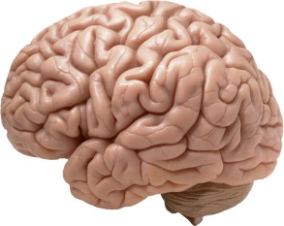
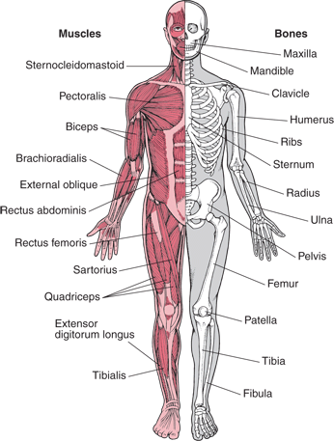
The Standard View
The brain:
Senses the environment,
Interprets it through perception,
Recognizes,
Remembers,
Reflects,
Decides what to do,
Plans a course of action,
Creates control signals,
Sends them to muscles,
………… to produce behavior.
Sense
Control
Think
Act

Slide 63
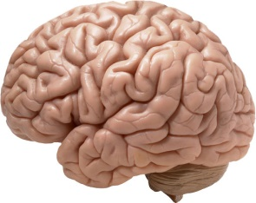

Embodiment
Control
The mind emerges from
the interaction of these!

Slide 64
Embodiment and Computation
Physics
Computation
All material systems:
Experience their environment.
Change their state in response.
Become reorganized over time.
Change their environment.
because of their form – from the molecular level up!
This is true of both computers and brains – and all tissue….
….. and rock and water…
All matter computes!
(That’s why analog computers are possible)

Slide 65
Living systems also:
Maintain internal organization through metabolism.
Develop and grow over time.
Reproduce to create new organisms similar to themselves.
Evolve into new species.
Animals with nervous systems:
Perceive their environment in complex ways.
Build and use memories over time.
Learn to improve their performance.
Change their environment in controlled ways.
All this is still because of their form …..
… but the nervous system makes a BIG difference.

Slide 66
Living systems also:
Maintain internal organization through metabolism.
Develop and grow over time.
Reproduce to create new organisms similar to themselves.
Evolve into new species.
Animals with nervous systems:
Perceive their environment in complex ways.
Build and use memories over time.
Learn to improve their performance.
Change their environment in controlled ways.
All this is still because of their form …..
… but the nervous system makes a BIG difference.
The brain is critical !!

Slide 67
What makes the nervous system special?
All cells in the body:
Sense their environment
Communicate with other cells
Respond to signals
Process information
Adapt their behavior
Act on their environment
But the nervous system has:
A huge variety of specialized cells.
Diversity of signaling and modulating chemicals.
The ability to make distinct, cell-specific connections.
Which enables:
Multiple methods of information representation at multiple scales.
Formation of specific, heterogeneous networks at many scales.
Coordination of specific activity patterns over networks.
Specific and associative adaptation of activity patterns.

Slide 68


Embodiment and the Brain
A system not at the mercy of a fixed embodiment.
Why not?
Because it has:
A body that changes with experience.
A brain that acts as an “adaptive switchboard” for the body.
A system at the mercy of a fixed
embodiment.

Slide 69
Main Lesson
It’s all in the networks!
Both the brain and the rest of the body are networks.

Slide 70
Fundamental Postulates
The animal is a self-organizing, complex network of networks embedded in a hierarchy of complex networks.
At each level, function emerges from form (e.g., protein shapes, neuron structure, network connectivity).
Information is represented and processed as dynamical patterns of activity over these networks.
These networks are reconfigured continually by processes at many spatial and temporal scales.
All perception, cognition and action emerges from the activity of these networks → thought and action are the same type of thing.

Slide 71
Implications for AI
It is not enough just to create algorithms.
It is not enough just to create artificial brains.
AI ultimately requires creating artificial animals → Robots, animats.
Artificial Intelligence Artificial Life
Algorithms and neural networks will play a big role …..
….. but the real action in AI will soon come from….
Biomorphic robots.
Biomorphic chips.
Brain-machine interfaces.
Brain implants.
Mind-controlled prosthetics……..

Slide 72
Creating Animals with Complex Behaviors
Option 1: Engineering
Build a complex animal with pre-designed complex behaviors.
Won’t work because:
Impossible to anticipate useful complex behaviors.
Impossible to think of every contingency.
Impossible to design efficient behaviors.
Cannot adapt to changing needs.
Will not scale up to larger, more complex animals.

Slide 73
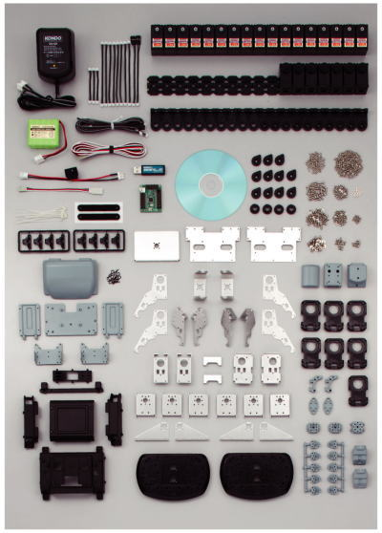
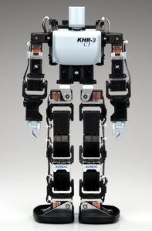

Creating Animals with Complex Behaviors
Option 2: Learning
Build a complex animal and have it learn complex behaviors.
Learn
This!
Won’t work because:
Too many degrees of freedom.
Too many possibilities to explore during learning.
Will not scale up to larger, more complex animals.

Slide 74
Creating Animals with Complex Behaviors
Option 3: Artificial EvoDevo
Gradually bootstrap to more complex animals by processes analogous to evolution and development.
Start with simple agents that learn to do simple things.
Produce increasingly complex agents in stages.
At every stage, learn more complex behaviors by building on those learned in earlier stages.
Will work because:
Task at each stage is constrained and simple.
Most bad choices are never considered.
No limit to growth in principle.

Slide 75
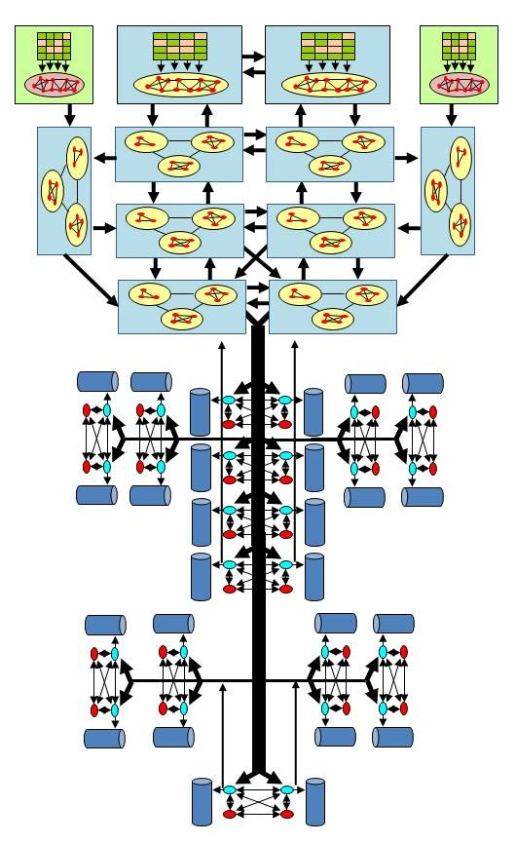
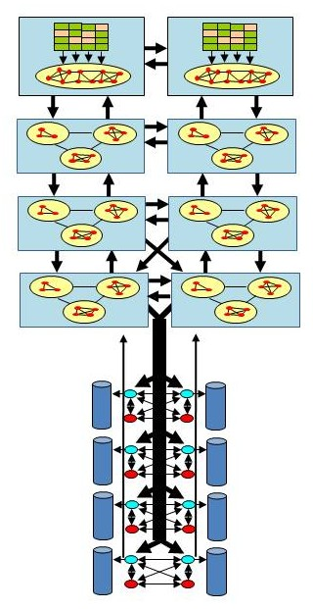
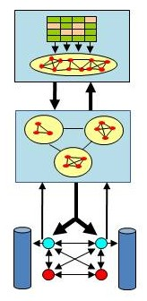
Key Enabler: Modularity
Modular construction is the key to efficient generation of complexity.
Simplifies growth.
Channels growth in useful directions.
Makes growth more efficient.
Increases stability and robustness.

Slide 76
Learning to Behave
One possible approach for learning behaviors:
Generate behaviors autonomously.
Learn useful ones by reinforcement.
Reject the others.
Repertoire of useful behaviors
But this works only if behavioral sampling is constrained and productive
List of possibilities:
Stand and stare.
Reach and pick up.
Turn away.
Kick the table.
Say “hello” to the cup
Make a face.
Jump up and down.
Scream.
Dance.
….
Recite Hamlet’s monologue
…..
Too many possibilities.
Mostly irrelevant.
Learning is not feasible!

Slide 77
Developmental Learning
Learning occurs in stages that match expanding choices with increasing control DoF.
Simple embodiment
Few choices.
Simple actions.
Few control degrees of freedom.
Build elementary repertoire.
Learn broad options.
Time
More choices.
More control DoF.
More working memory.
Mirror system.
Construct complex sequences.
Add to repertoire as chunks.
Even more choices.
Even more control DoF.
More complex repertoire.
Construct more complex sequences.
Add to repertoire as chunks.
At every stage, most choices are truncated
Much smaller option space
Learning!

Slide 78
What We Still Don’t Understand Fully
Fast, reliable action from slow, noisy components.
Rapid learning – often in a single experience.
Rapid construction of complex voluntary movements.
Volition and planning.
Fluent thought and expression.
Creativity.
And a whole lot more!
Even deep learning hasn’t helped much!

Slide 79
The Path to AGI
Real AI will be:
Embodied (brain + body, not just brain).
Emergent (not driven by specific tasks/goals).
Unsupervised + reinforced (with very fast RL).
Developmental (learning in stages building on prior stages).
Hierarchical (more complex functions by combination of less complex ones).
Self-motivated (active learning).
Generative (able to imagine and learn from imagination).
Inherently abstractive and analogical (transfer learning across domains).
Empathetic (have a theory of other minds).
Heuristic (rooted in innate evolutionary priors).
Non-parametric (not based on abstract prior models).

Slide 80
The Path to AGI
It will not use:
Optimization / supervised learning.
IID sampling from assumed distributions.
Slow, iterative learning.
Large amounts of data.
Specific tasks.
AI will undergo a great transformation in its priorities and approaches over the next 5-10 years.
An important fact to keep in mind:
Creating AGI = Creating a new species with totally different biology!

Slide 81
Shallow Adaptation
Design a complex physical system (body)
Implement complex algorithms/NN for specific functions
Optimize performance by learning on data
Shallow Adaptation
Data
Most current AI systems use shallow adaptation: Learning specific tasks from data. As a result, they are:
Data. And computation-intensive
Task-specific and model-dependent
Ungrounded in reality (grounded in data)
Unable to learn continuously
Fragile in non-stationary situations

Slide 82
Shallow Adaptation
Design a complex physical system (body)
Implement complex algorithms/NN for specific functions
Optimize performance by learning on data
Shallow Adaptation
Data
Most current AI systems use shallow adaptation: Learning specific tasks from data. As a result, they are:
Data- and computation-intensive
Task-specific and model-dependent
Ungrounded in reality (grounded in data)
Unable to learn continuously
Fragile in non-stationary situations
Unsuitable for natural intelligence

Slide 83
Deep Adaptation
Deep adaptation is:
Evolutionary and developmental
Adaptive at multiple scales
Always integrated
Inherently versatile
Grounded in reality
Mainly unsupervised
Computationally efficient
Continually adapting
Start with a simple network of networks physical system
Evolution
Complexify the design by adding and modifying modules
Development
Release more degrees of freedom in stages
Deep Adaptation
Fitness
Evaluation
Real
World
Neural learning is only one of the levels of learning.
Supervised learning is used only to learn complex tasks on top of base intelligence.
Learning
Learn by building on previous learning via experience
Individual Animal

Slide 84
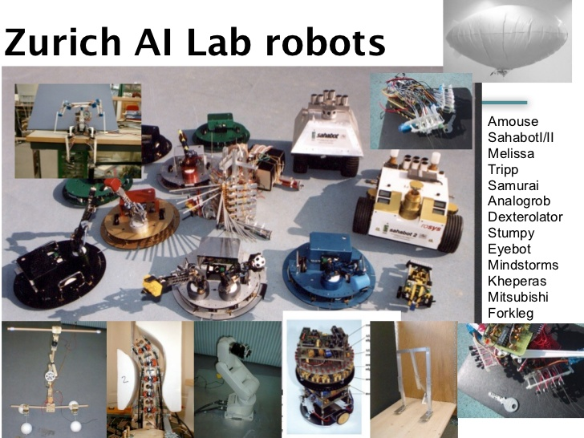
These are the early ancestors of Mr. Data and Skynet …..
For lots of interesting stuff on embodied intelligence, check out: http://www.slideshare.net/swissnexSF/embodied-intelligence-the-four-messages

Slide 85

The Shape of Things to Come
Click on this link for more interesting stuff.

Slide 86
Part V: AI and the Future

Slide 87
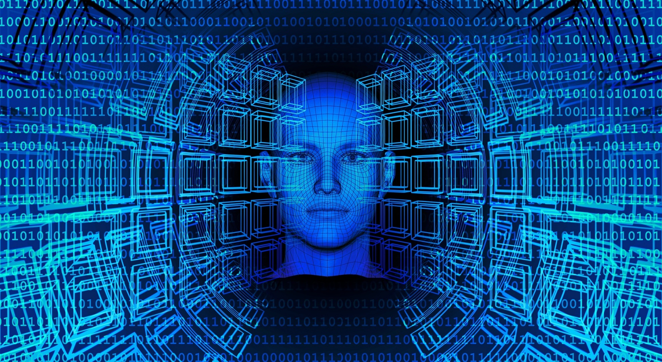
“AI is the new electricity”
Andrew Ng (Stanford University)
Image from pixabay.com
Image from pixabay.com

Slide 88
What does “AI is the new electricity” mean?
It means that AI will be the next great integrator of our lives.
Just as electrical power pervaded every aspect of life in the 20th century, AI will do so in the 21st - but unlike electricity, AI plays with our minds!
Pervasiveness of AI:
Now:
Engineering
Appliances
Electronics
Information technology
Communication
Entertainment
Transportation
Manufacturing
Commerce
Finance
Cybersecurity
Law enforcement
Soon, add:
Education
Art
Design
Science
Innovation
Politics
Law
Economics
Policy-making
Governance
Geopolitics
Warfare
Eventually:
Social norms
Morality & ethics
Relationships
Societal structure
Civilization

Slide 89
AI has great benefits
AI will revolutionize medicine and healthcare at every level.
AI will make life much easier for a lot of people – e.g., those with disabilities.
AI will supercharge innovation, invention, and even scientific discovery.
AI will transform and increasingly automate engineering.
AI will make education more accessible, enriched, and effective.
AI will transform communication, media, and entertainment.
AI will help in combating the existential threat of climate change.
AI will greatly reduce the hazards of human error.
AI will broadly increase institutional efficiency.

Slide 90
AI also has great risks
AI is the first time we are outsourcing complex decisions to non-human entities.
AI will change the way people think – e.g., outsourcing knowledge.
AI will change the nature of human interaction – e.g., VR/AR/metaverse.
AI will alter the norms of society radically – e.g., hyper-rationality.
AI will supercharge false beliefs, misinformation, and conflict.
AI will increase the intrusive and coercive power of governments.
AI will make warfare more efficient, lethal, and impersonal.
AI will create massive economic dislocation – loss of whole professions.
AI will increase socioeconomic and geopolitical inequality.
By the time we fully grasp the hazards of AI, it will probably be too late.

Slide 91
Challenges
The Challenge of Autonomy:
Three levels of autonomy: Operational; Decision-making; Goal-setting.
Do we want a servant or a truly autonomous system?
How do the system’s goals align with ours?
How do we keep the system from going rogue?
The Challenge of Bias:
Data-induced biases – how much control do we have over data?
Essential biases of human intelligence – some good, some bad!
The Challenge of Expainability/Verifiability:
The model is opaque – data driven, deeply nonlinear.
The model is abstract – no meaningful internal primitives.
The Challenge of Validation:
Ground truth is often unavailable.
The system is not fully controllable.
The Challenge of Values:
Where does the system get its values?

Slide 92
The Challenge of Autonomy
Intelligence = Making smart/efficient/productive choices
Throughout history, only humans have made important choices for humans
AI is the first time that we are outsourcing important decision-making to autonomous machines
Levels of autonomy
Autonomy of execution – the AI executes your plan to achieve your goal
Autonomy of planning – the AI comes up with a plan to achieve your goal
Autonomy of purpose – the AI has its own goals and executes its own plans
Current AI applications are mostly at Stage I, AI games are at Stage II, but should we avoid getting to Stage III? Can we? Or are we already on a slippery slope?

Slide 93
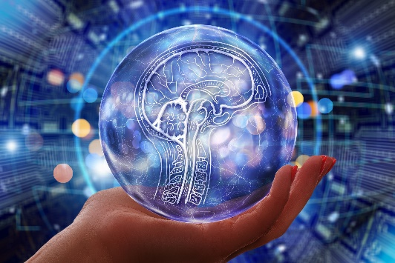
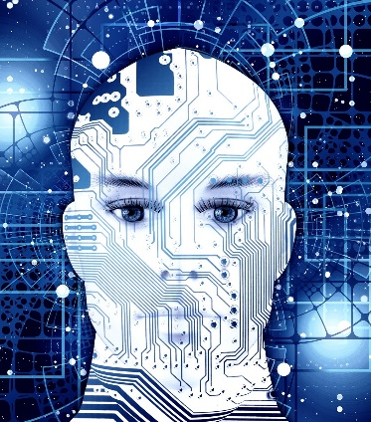
Two Visions of AI
Building smart tools
Systems that can:
Intelligently process a lot of information and data.
Help us make smarter decisions.
Take care of routine tasks automatically.
Do skilled tasks like driving, construction, etc., automatically.
Work as intelligent assistants in surgery, law, education, science, etc.
or
Building artificial minds
Systems capable of:
Thinking, planning and imagination.
Innovation and creativity.
Making truly autonomous choices.
Having their own values,
Images from pixabay.com

Slide 94
Two Visions of AI
Building smart tools
Systems that can:
Intelligently process a lot of information and data.
Help us make smarter decisions.
Take care of routine tasks automatically.
Do skilled tasks like driving, construction, etc., automatically.
Work as intelligent assistants in surgery, law, education, science, etc.
Narrow AI = ML
Intelligent Automation
Intelligent Assistance
Intelligent Advice
Intelligent Action
or
Building artificial minds
Systems capable of:
Thinking, planning and imagination.
Innovation and creativity.
Making truly autonomous choices.
Having their own values,
Artificial
General
Intelligence
(AGI)
Images from pixabay.com

Slide 95
Two Visions of AI
Smart Servant
Building smart tools
Systems that can:
Intelligently process a lot of information and data.
Help us make smarter decisions.
Take care of routine tasks automatically.
Do skilled tasks like driving, construction, etc., automatically.
Work as intelligent assistants in surgery, law, education, science, etc.
AI Today
or
Building artificial minds
Systems capable of:
Thinking, planning and imagination.
Innovation and creativity.
Making truly autonomous choices.
Having their own values,
Independent Peer
AI Tomorrow?
Images from pixabay.com

Slide 96
Ethical Challenges
AI will pose very significant ethical challenges, including the following:
Assignment of Responsibility: As AI becomes more autonomous, how will it be found responsible and held accountable for its choices?
Inhumane Values: With increasing autonomy, the values underlying the choices made by AI will become more important – and they may not always accord with values preferred by humans.
Assumption of Objectivity: Because of the human bias to see machines as rational, a much higher degree of objectivity may be assigned to the choices made by AI even when they are inhumane or oppressive – especially if they suit narrow agendas of power.

Slide 97

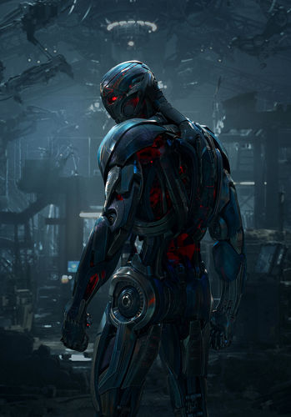
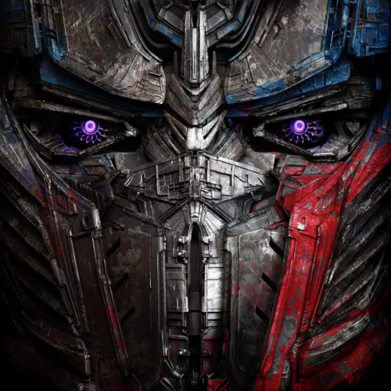
How people fear AI will take over the world
Ultron
Optimus Prime

Slide 98
How people fear AI will take over the world
Ultron
Optimus Prime
How AI will actually take over the world
By making us dependent on it in our daily lives
By becoming critical to the functioning of human relationships
By becoming our primary source of information and knowledge
By enhancing our capabilities and making this enhancement essential
By shaping our sense of reality via AR/MR/VR etc.

Slide 99
What we will do in this class
Define the basic concepts needed to understand and build intelligent systems.
Briefly review information processing in the brain.
Study neural network methods (and a few others) for the fundamental intelligent systems tasks such as classification, pattern recognition, clustering, and memory.
Feed-forward networks with supervised learning.
Unsupervised learning in neural networks (clustering and feature maps).
Recurrent neural networks and associative memory.
Introduction to deep learning.
K-nearest neighbor algorithms.
Bagging and boosting.
K-means clustering.
Etc.

Slide 100
For more general discussions on AI, look at these:
OPenAI on GPT2: https://openai.com/blog/better-language-models/
Tony Zador on learning from animal brains:
https://www.nature.com/articles/s41467-019-11786-6?fbclid=IwAR18H6BQ9Wl4Pll09a2pUmDnNAxU31q2xOMOQLtuZ7DVnUqXZ_M0Tk0J71w
David Deutch on doing AI right:
https://aeon.co/essays/how-close-are-we-to-creating-artificial-intelligence?fbclid=IwAR2mJRUas-g3_IgRVR9yxD8jltCmhbvhi2JaPPa08gKrGIhGTGm2UuFqkak
Groth, Nitzberg and Russell on AI algorithms:
https://www.wired.com/story/ai-algorithms-need-drug-trials/?fbclid=IwAR1__eJb4GCIiLw23_K0BVBxJX-TZxeF7MDVOHgz_Eg_35crLz8OB_nVwEA
Derek Thompson on A World Without Work: https://www.theatlantic.com/magazine/archive/2015/07/world-without-work/395294/
….. and more

Slide 101
For an assessment of the state of AI today, read the 2022 AI Index
https://hai.stanford.edu/research/ai-index-2022

Slide 102
Melanie Mitchell on The Barrier of Meaning:
https://aaai.org/ojs/index.php/aimagazine/article/view/5259
https://www.nytimes.com/2018/11/05/opinion/artificial-intelligence-machine-learning.html
https://pdxscholar.library.pdx.edu/compsci_fac/194/
Questioning the direction of AI today:
https://www.technologyreview.com/2020/08/18/1007196/ai-research-machine-learning-applications-problems-opinion/
https://spectrum.ieee.org/deep-learning-computational-cost#toggle-gdpr
https://www.theatlantic.com/technology/archive/2021/09/eric-schmidt-artificial-intelligence-misinformation/620218/
On the importance of mistakes for intelligence:
https://www.newyorker.com/science/maria-konnikova/why-are-babies-so-dumb-if-humans-are-so-smart

Slide 103
General Books
M. Mitchell, “Artificial Intelligence: A Guide for Thinking Humans”, Farrar, Strauss, and Giroux, 2019.
G. Marcus and E. Davis, “Rebooting AI: Building Artificial Intelligence We Can Trust”, Pantheon, 2019.
M. Tegmark, “Life 3.0: Being Human in the Age of Artificial Intelligence”, Knopf, 2017.
N. Bostrom, “Superintelligence: Paths, Dangers, Strategies”, Oxford University Press, 2016
Textbooks
C.C. Aggarwal, “Neural Networks for Deep Learning: A Textbook”, Springer, 2018.
E. Alpaydin, “Introduction to Machine Learning”, MIT Press, 2010.
K.P. Murphy, “Machine Learning: A Probabilistic Perspective”, MIT Press, 2012
I. Goodfellow, Y. Bengio and A. Courville, “Deep Learning”, MIT Ptress, 2016.

Slide 104
To read some of my opinions on AI:
http://barbarikon.blogspot.com/2014/04/understanding-artificial-intelligence.html
https://www.3quarksdaily.com/3quarksdaily/2015/08/fearing-artificial-intelligence.html
https://www.3quarksdaily.com/3quarksdaily/2017/03/artificial-stupidity.html
https://www.3quarksdaily.com/3quarksdaily/2019/02/what-ai-fails-to-understand-for-now.html
https://3quarksdaily.com/3quarksdaily/2020/12/to-build-a-terminator.html
https://3quarksdaily.com/3quarksdaily/2021/06/between-golem-and-god-the-future-of-ai.html

